Slide 1
BC201: Advanced Statistics
Michail Tsagris & Ioannis Tsamardinos

Slide 2
What is statistics?
Statistics in some is extraction of decisions under uncertainty, i.e. tries to quantify uncertainty.
Shall I take an umbrella with me today?
Shall I buy the airplane ticket now or wait a few days?
A simple analysis of the Challenger’s previous tests would have shown that in low temperatures, the aircraft explodes. That day, the temperature was $0^{o}.$

Slide 3
What is statistics?
Given a sample of observations we want to draw some conclusions about the population.
Gallup surveys is the most known example related to the terms sample and statistics.

Slide 4
Where can statistics be applied?
Medicine, biology, pharmaceuticals, computer science, sports, psychology, sociology, marketing, chemistry, physics, archaeometry, linguistics, army, real estate, political sciences, ecology, forensics.

Slide 5
What do we need to do statistics?
We need data, measurements, observed quantities.
We need to do a survey, design a study or experiment in order to get data.
Two main directions:
Observational studies: Simply record the quantities of interest, have no effect on the data, watcher, spectator.
Experimental studies: Control some parameters, have effect on how the data are gathered.

Slide 6
Types of studies
Descriptive surveys, simply report some summary statistics.
Analytical studies, extract information and draw conclusions.
Cohort, prospective, longitudinal, follow-up studies where the data are measured through time.
Restrospective studies, case control studies, matched pairs.
Cross-sectional studies.
(Complete) Randomised experiments.
Single or double blind clinical trials.

Slide 7
Measurements, quantities of interest, data, variables
The variables are defined as quantitative, numerical, and qualititative, categorical.
Quantitative variables are numbers, where mathematical operations (e.g. summation, multiplication) make sense.
Qualitative variables do not accept mathematical operations per se.

Slide 8
Quantitative variables
Continuous data: age, weight, height, bmi index, cholesterol and glucose levels, gene expressions.
Discrete data: Age, number of white or red blood cells, number of children, number of daily admittances in a hospital.

Slide 9
Qualitative or categorical variables
Nominal valued: blood type (A, B, 0, AB), gender (Male, Female), race (Black, White, Asian, Mixed), smoking (Yes, No)
Ordinal valued: satisfaction level, (dissatisfied, neutral, satisfied), classes of birth weight (low, normal, high).

Slide 10
Other types of data
Proportions (percentages): values between 0 and 1.
Compositional data: vector of proportions which sum to 1. For example, (0.20, 0.40, 0.10, 0.30).
Circular data: The measurements consist of angles from a reference line, 30⁰, 45⁰, 60⁰.
Spherical data: latitude and longitude.
Repeated measurements: For the same subjects we measure the same characteristics multiple times.
Longitudinal or time course data: Repeated measurements over time. Gene expressions is a good example.
Rankings: For example, the final order of teams in a sport.

Slide 11
Population and sample
These are two very important concepts and we must explore them further.
Sample: A small set of values coming from a larger set (population), a collection of units.
The sample is used to make inference about the whole population.
Why sample and not population? Because sampling is much cheaper and easier to collect than population and many times the only feasible thing to do.

Slide 12
Population and sample
Population types
Target population: the population of interest.
Frame population: a list of sampling units to choose from, or a map in case of geographical coverage problems. The target and the frame populations often do not exactly coincide.
Survey population, which consists of the units that one could select in case of a 100% sampling.

Slide 13
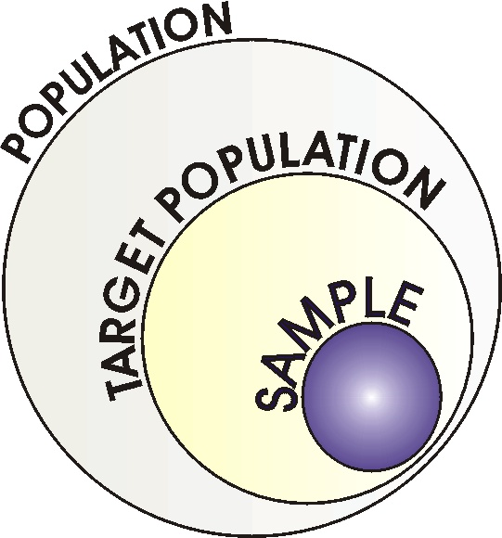
Population and sample

Slide 14
Population and sample
Target population: Young students of biology departments in Greece (regardless of year of study).
Survey population: All university students in Greece.
Sample: Some students from some biology departments in Greece.
The conclusions are for the biology students only, not any student in general, not for children, not for working or retired people.

Slide 15
Sampling techniques
In observational studies there are 4 basic sampling techniques:
Random sampling: collect blood samples from random people.
Stratified random sampling: divide the city into blocks and collect the same information from random people at each block.
Systematic sampling: collect this information from the 1st, 11th, 21st, 31st and so on, person.
Cluster sampling: choose a few neighbourhoods from the city at random and ask all the people in the blocks.

Slide 16
Summary statistics for data
Quantitative data.
Mean, median, first and third quartile, minimum, maximum, range, variance and standard deviation, coefficient of variation.
Qualitative data.
Percentages, modal value (most frequent value).

Slide 17
Summary statistics for data
Median: Sort the data from minimum to maximum and take the (middle) number that splits the numbers in half.
First quantile: the number which splits the data in 25%-75%.
Third quantile: the number which splits the data in 75%-25%.
Median is hence the second quantile.
Range is defined as maximum – minimum.
The variance and hence the standard deviation show how spread the data are.
Coefficient of variation is the ratio of the standard deviation to the absolute value of the mean. It shows the heterogeneity of the data.

Slide 18
Example with continuous data
x = 1, 2, 3, 4, 5, 6, 7, 8, 9, 10
$\overline{x}=\frac{1+…+10}{10}=$ 5.5 med = 5.5
min = 1, max = 10, R = 10 - 1 = 9
Q₁ = 3.25, Q₃ = 7.75,
$s^{2}=\sum_{i=1}^{n}{\frac{{\left(x_{i−}\overline{x}\right)}^{2}}{n−1}}= \frac{{\left(1−5.5\right)}^{2}+ …+{\left(10−5.5\right)}^{2}}{10−1}$ ^{= 9.167}
$s=\sqrt{s^{2}}= \sqrt{9.167}=3.028.$
$cv=\frac{s}{\left|\overline{x}\right|}=\frac{3.028}{5.5}=0.55$ or 55%.

Slide 19
Example with categorical data
55% males and 45% females.
60% healthy and 40% unhealthy patients.
10% low-weight babies, 60% normal weight babies and 30% overweight babies.
The most frequent case of baby weights is the normal-weight one.

Slide 20
Graphical representation of data
Quantitative variables
Histogram (one variable), scatter plot (pairs of variables), box plot, one or more variables, dot plot.
Qualitative variables
Bar chart (one or two variables), pie chart (one variable).
Tables of frequencies for one, two or three variables.
Mixtures of both
Scatter plot(one or two continuous and one categorical), histogram (two or more continuous, indicated by a categorical one), box plot (one continuous and one categorical).

Slide 21
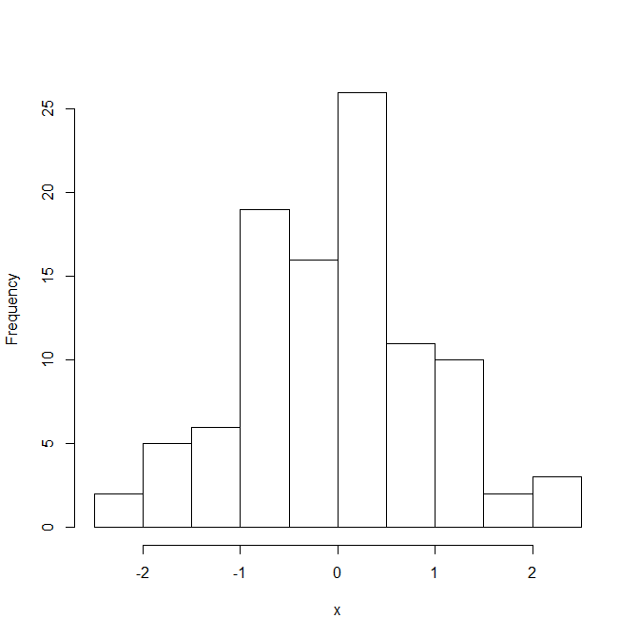
Histogram and box plot

Slide 22
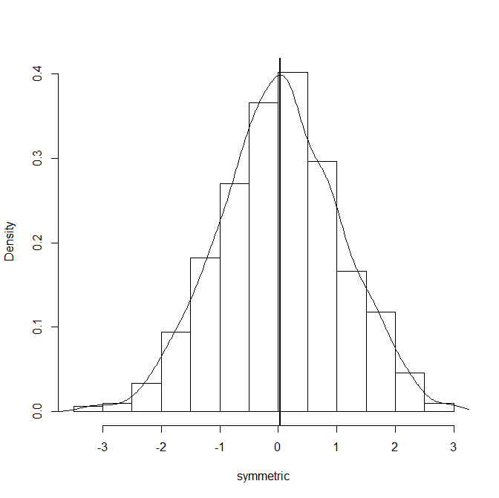
Histogram
Symmetric distribution: mean = median

Slide 23
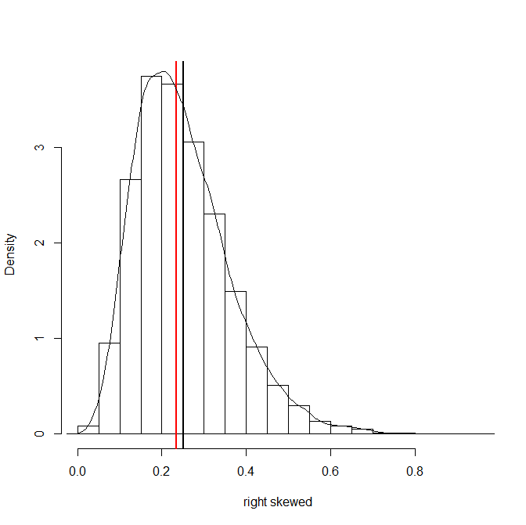
Histogram
Right skewed : median (red) < mean (black)

Slide 24
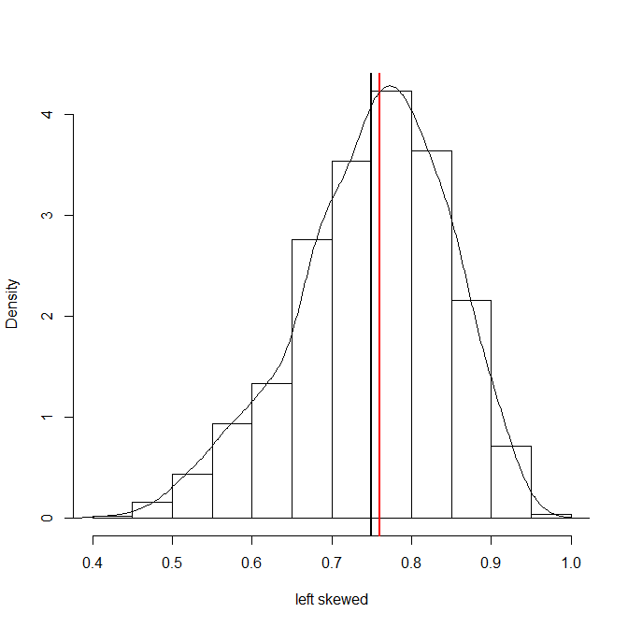
Histogram
Left skewed : median (red) > mean (black)

Slide 25
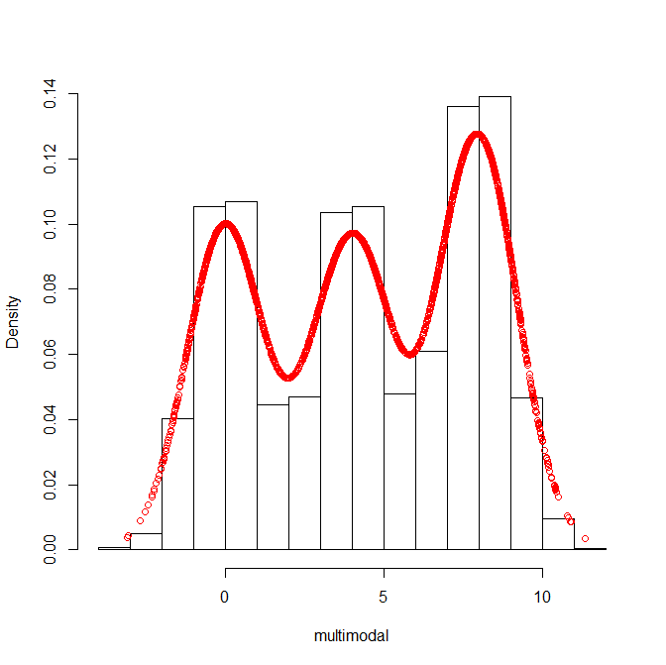
Histogram

Slide 26
Tables for categorical data
 |  | Gender
 |  | Male | Female
Cancer | Yes | 50 | 10
 | No | 3 | 5

Slide 27
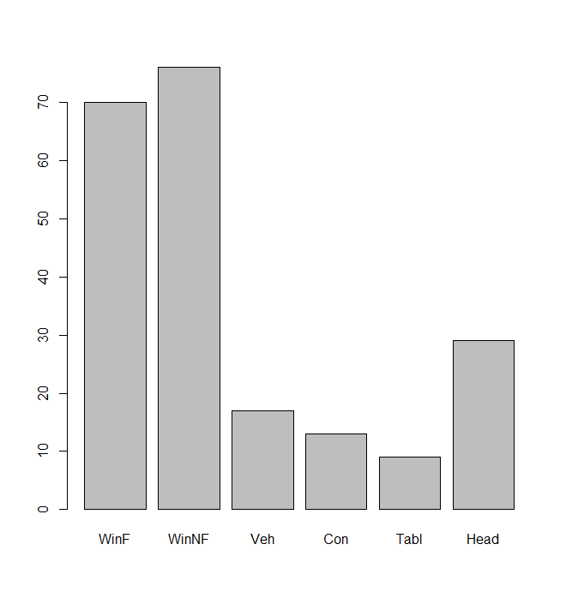
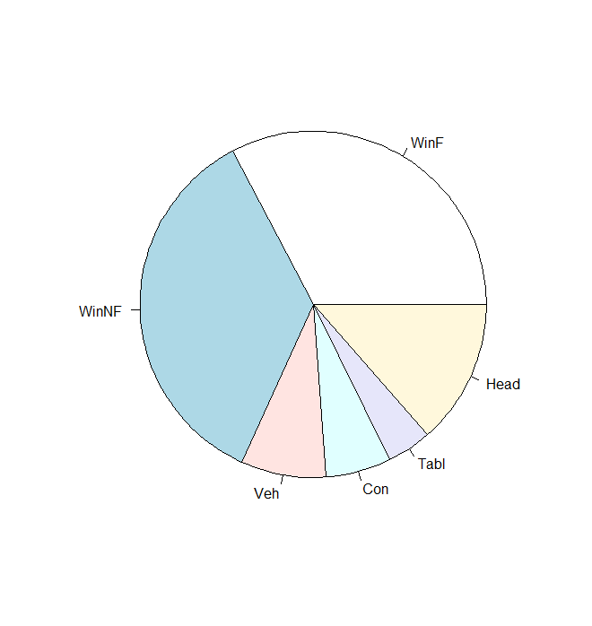
Bar and pie chart

Slide 28
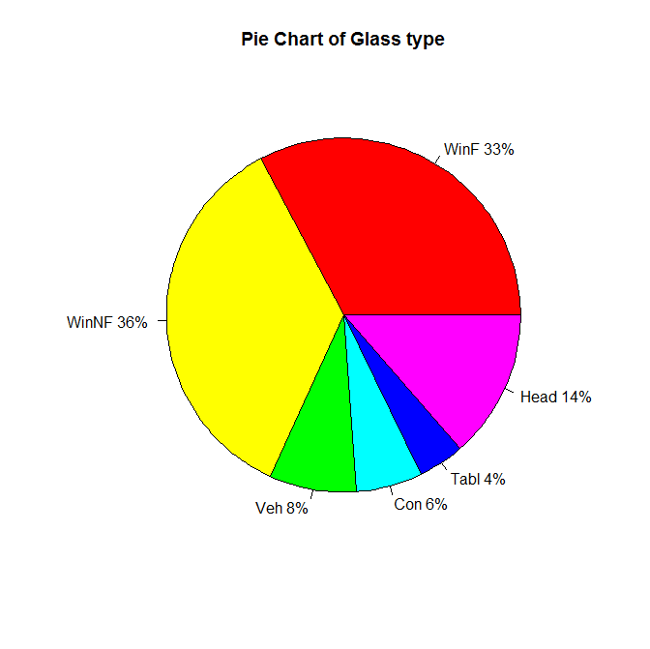
Pie chart

Slide 29
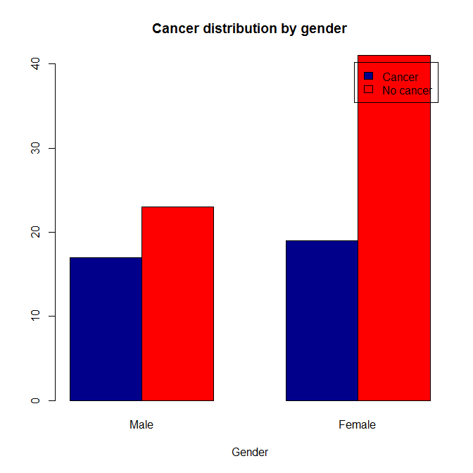
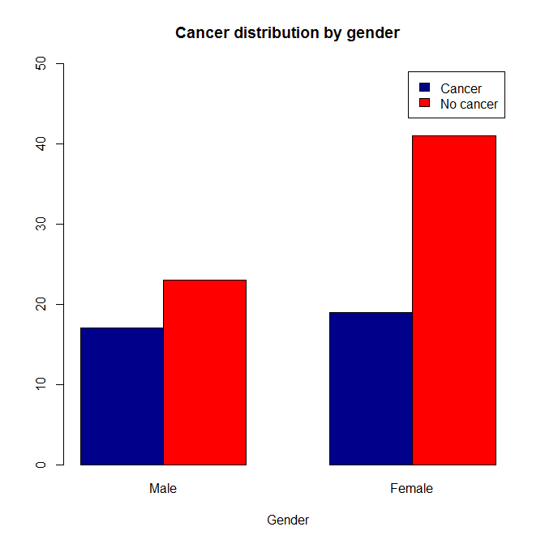
Bar chart

Slide 30
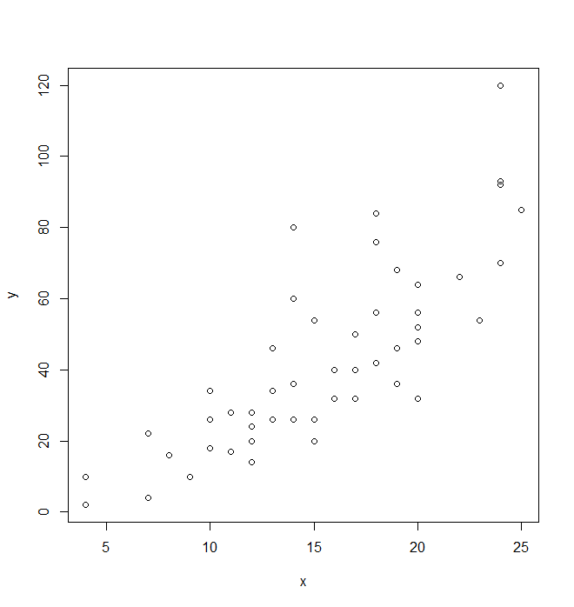
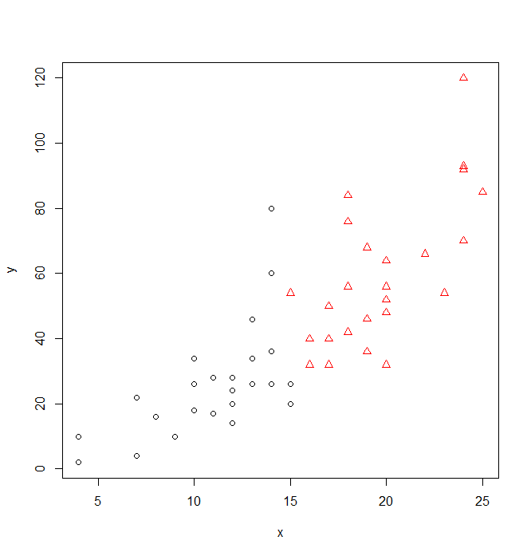
Scatter plot

Slide 31
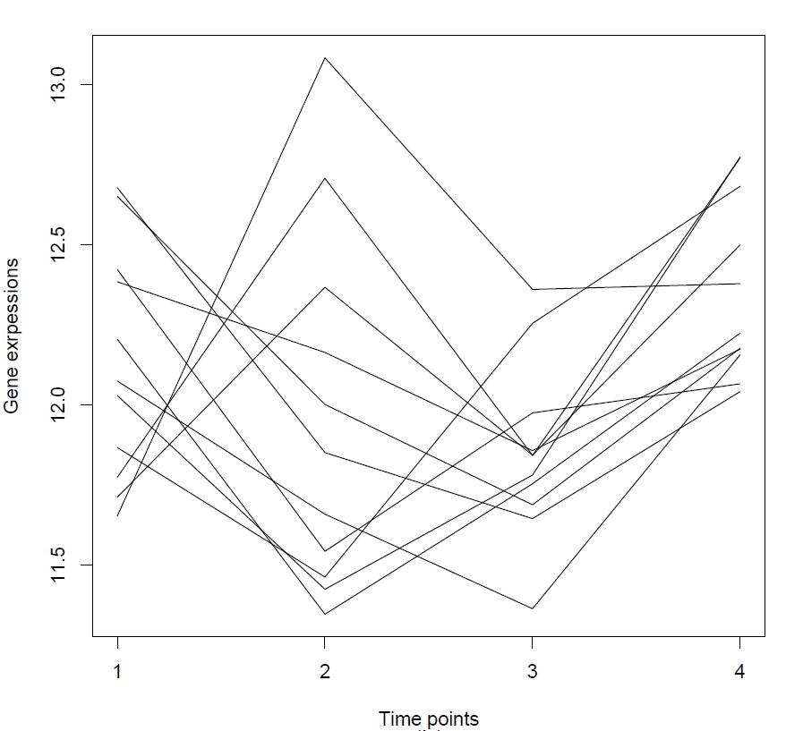
Time course data
Gene expressions over time

