Slide 1
Hypothesis testing
Michail Tsagris & Ioannis Tsamardinos

Slide 2
The Null Hypothesis
The hypothesis we may want to “accept” is called the Alternative Hypothesis
Sometimes denoted as H₁
The hypothesis we hope to reject, the negation of the Alternative Hypothesis, is called the Null Hypothesis
Usually denoted by H_{o}

Slide 3
The Need for a Test Statistic
Let x₁, …, x_{n} be the vectors with our data (e.g., each patient vector)
x = ⟨ x₁, …, x_{n} ⟩
x is the matrix with our data
Ideally, we would like to calculate:
P(obtaining data similar to x | H₀)
(Why not calculate P(x | H₀)?)
This is typically very difficult

Slide 4
Test Statistics
A test statistic is a function of our data: T(X),
e.g., if X contains a single quantity (variable) T(X) the mean value of X
T is a random variable (since it depends on our random variables, the data)
We denote with t_{o} = T(x) is the observed value of T in our data
Instead of calculating
P(obtaining data similar to X | H₀)
we calculate
P(T similar to t_{o}| H₀)
If P(T similar to t_{o}| H₀) is very low, while P(T similar to t_{o}| H₁) is high, we reject H₀

Slide 5
Standard Single Hypothesis Testing
Form the Null and Alternative Hypothesis
Gather related data
Find a suitable test statistic T
Find the distribution of T given the null
Depending on the distribution of T and the observed t_{o} =T(x)
decide to reject or not H₀

Slide 6
Form the Null Hypothesis
Gene G is expressed differently in breast cancer patients with mutation in BRCA1 than BRCA2
Mathematically?
μ₁ : be the mean expression level of gene G in patients with BRCA1 mutation
μ₂ : be the mean expression level of gene G in patients with BRCA2 mutation
H₀ : μ₁ = μ₂
H₁ : μ₁ ≠ μ₂

Slide 7
Gather Related Data
Send your biologist friend to do an experiment for you
got to get a grant to get the money
find the biologist
pay him/her
wait for a few months
get the data
realize there has been some mistake
force him/her to do it again
etc. etc.

Slide 8
How to Construct a Test
Find a test statistic T that easily takes extreme values when H₀ is not true
Find how to theoretically calculate the distribution of T
hopefully, without too many other assumptions
Our example described the application of what is called a t-test
assumes two groups, normality, same variance, independent sampling
other types of t-tests exist that remove some of the assumptions

Slide 9
Statistical Errors
Assuming all the other assumptions of the test hold what types of errors can we make?
Decision Truth | Accept H₀ | Reject H₀
H₀ |  | Type I error
H₁ | Type II error
Decision Truth | Accept H₀ | Reject H₀
H₀ | True Negative | False Positive
H₁ | False Negative | True Positive

Slide 10
Statistical Errors
Decision Truth | Accept H₀ | Reject H₀
H₀ | P(T ∉ Γ, H₀) | P(T ∈ Γ, H₀)
H₁ | P(T ∉ Γ, H₁) | P(T ∈ Γ, H₁)
Out of these, which ones can we compute?

Slide 11
Statistical Errors
Decision Truth | Accept H₀ | Reject H₀
H₀ | P(t ∉ Γ | H₀) P(H₀) | P(t ∈ Γ | H₀) P(H₀)
H₁ | P(t ∉ Γ | H₁) P(H₁) | P(t ∈ Γ | H₁) P(H₁)
We showed we can compute P(T ∈ Γ | H₀)
Under additional assumptions, we can calculate P(T ∉ Γ | H₁)
We could compute the rest under more assumptions
Requires a different semantic interpretation of probability, called Bayesian Statistics

Slide 12
Minimize Statistical Error
Problem 1: minimize the total number of errors
Problem 2: minimize a weighted sum of errors
desirable if one type of error is more serious than another
Problem 3 (standard statistics):
minimize Type II errors
while Type I errors are below a threshold

Slide 13
Minimize Statistical Errors
Find test statistics and rejection regions s.t.
Guarantee Type I errors are below a given level a
Type I error ≤ P(T ∈ Γ | H₀) = a
we say the test controls Type I error rate
While minimizing Type II errors
that is maximizing power : P(T ∈ Γ | H₁)

Slide 14
Statistical Significance
We set a threshold a (=0.05 often)
We find a value c, s.t. P(|T| ≥ c | H₀) = a
this defines our rejection region
We reject H₀ if |t_{o}| ≥ c, thus we control the Type I error rate to be less than a
a is called the significance level of the test procedure

Slide 15
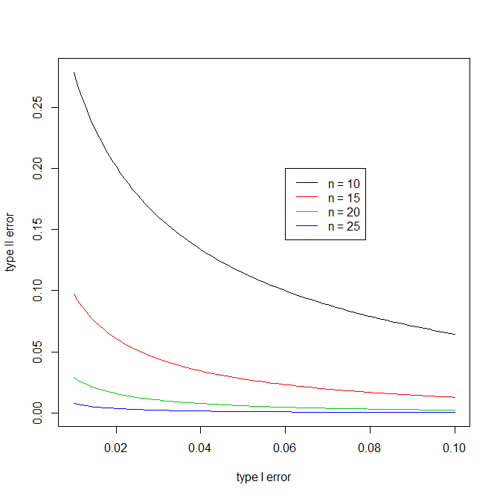
Relationship between type I and type II errors
Trade-off between low
type I and type II errors.
Larger sample corrects
for both.

Slide 16
p-values
For a significance level a, we report whether we reject H₀ or not
Or better,
We calculate the minimum a that would still have rejected H₀ (p-value)
p = P(|T| ≥ |t₀| | H₀)
A finding is statistically significant at level a, iff p ≤ a
In the first example,
we can reject the hypothesis μ₁ = μ₂ at level 0.05
the p-value is 0.004

Slide 17
p-value
The probability of obtaining a test statistic as extreme or more as the one we have obtained, given H₀

Slide 18
Regarding the Choice of a Test
When we cannot reject H₀ does not mean H₁ holds
It could be that we don’t have enough power, i.e.,
H₁ is not that “different enough” from H₀ to distinguish it with the given sample size we have
Of all possible tests for a hypothesis choose the one with the maximum power
tests with more assumptions are typically more powerful
e.g., our t-test assumed normally distributed data

Slide 19
Scientific Questions
Mathematics:
Is P=NP?
Natural Sciences and Other Sciences
Pharmacology: Does medicine A help patients recover more quickly from disease B?
Biology: Does gene A “cause” disease B?
Computer Science: Is algorithm A more time-efficient than algorithm B?

Slide 20
Proving Your Hypothesis
Reaching a contradiction in mathematics
We already know a set of axioms and theorems, say K
We want to show the theorem (hypothesis) H, e.g., “H: P=NP”
We show K, ¬H ⇒ False (contradiction)
Thus, if we trust that K holds indeed, ¬H cannot hold and H must hold

Slide 21
“Proving Your Hypothesis”
Mathematics
We already know a set of axioms and theorems, say K
We want to show the theorem (hypothesis) H, e.g., “H: P=NP”
We show K, ¬H ⇒ False (contradiction)
Thus, if we trust that K holds indeed, ¬H cannot hold and H must hold
Real World
We already “know” K
We want to show a hypothesis H, e.g., “H: medicine A reduces the mortality of disease B”
We gather data from the real world. We show that
K, ¬H makes it very unlikely to observe our data
We conclude that ¬H is very unlikely. We reject ¬H, we accept H

Slide 22
Example: Hedenfalk et al. N Engl J Med. 2001 Feb 22;344(8):539-48.
Background knowledge
Breast Cancer is related to mutations in genes BRCA1 and BRCA2.
Forming the Hypothesis
Gene G is expressed differently in breast cancer patients with mutation in BRCA1 than BRCA2
Data gathering:
Obtained 7 patients with BRCA1 mutation, and 8 with BRCA2 mutation

Slide 23
Find a suitable test statistic T
The larger the difference of the two means, the larger the statistic
The larger our sample it is the larger the statistic
The smaller the sample variance, the larger the statistic
So, …, T will be quite large (in absolute value) when we can confidently say H₀ does not hold

Slide 24
Find the distribution of T
Go to your statistician friend and ask him, open a statistics book, prove it yourself (!) etc.
if
the data in both groups are distributed normally around a mean value μ₁ and μ₂ respectively
their variance is the same in both groups (?)
Each patient was sampled independently
and most importantly,
THE NULL HYPOTHESIS HOLDS
(a-c) are specific assumptions for this test, (d) is an assumption for ALL tests
then

Slide 25
Find the distribution of T
T(X) when X has 15 patients has a probability density function of:
where v is 15 – 2=13 (number of patients – 2)
v is called the degrees of freedom of the test

Slide 26
Find the distribution of T

Slide 27
Decide to Reject Or NOT
Depending on the distribution of T and the observed t_{o} =T(x)
decide to reject or not H₀
Should we or should we not
If yes, what’s the probability we err?

Slide 28
Decide on a Rejection Region
Decide on a rejection region Γ in the range of our statistic
If t_{o} ∈ Γ , then reject H₀
If t_{o} ∉ Γ , then do not reject H₀
accept H₀ ?
Since we know the pdf of T when the null hypothesis holds we can calculate P(T ∈ Γ | H₀)

Slide 29
Decide on a Rejection Region
If P(T ∈ Γ | H₀) is too low, we know we are safely rejecting H₀
However, we would also like P(T ∈ Γ | H₁) to be high
What should be our rejection region in our example?

Slide 30
Decide on a Rejection Region
where extreme values of t_{o} are:
unlikely to come from when H₀ is true
could come with high probability, when H₀ is false
P(T ∈ Γ | H₀) is the area of the shaded region (can be calculated)
Γ region of rejection

Slide 31
Typical Rejection Regions
Typically, test statistics get extreme (too high or too low) values with low probability, when H₀ holds
In our example, Γ = {t:|t|>3}

Slide 32
Rejection Procedure
We pre-select a probability threshold a
We find a rejection region Γ ={t:|t|>c} such that
P(T ∈ Γ | H₀) = a
We decide
Reject H₀ if t_{o} ∈ Γ (recall: t_{o} is the observed T in our data)
Accept H₀ otherwise
What values do we usually use for a in science?
0.05 is the most typical
smaller ones are also used: 0.01 , 0.001 etc.
When t_{o} ∈ Γ we say the finding is statistically significant at significance level a

Slide 33
Example (hypothetical) Data revisit
Patient number | Expression Level of Gene G | Have mutation in BRCA1 or not
1 (x₁) | 98.2244 | 1
2 | 69.6810 | 1
3 | 118.4339 | 1
4 | 115.2322 | 1
5 | 150.7729 | 1
6 | 117.7385 | 1
7 | 80.6921 | 1
8 | 142.8455 | 1
9 | 156.8692 | 2
10 | 151.9287 | 2
11 | 147.3357 | 2
12 | 131.2094 | 2
13 | 150.3127 | 2
14 | 147.0670 | 2
15 (x₁₅) | 122.3306 | 2

Slide 34
One sample t-test
Can we assume that the true mean of the expressions is equal to 100?
$H_{0} :μ=100$ versus $H_{1}:μ≠100.$
The test statistic is
$T= \frac{\left|\overline{x} −μ\right|}{S/{\sqrt{n}}}$ . If $T≥t_{1−\frac{a}{2}, n −1}$ reject $H_{0}$.

Slide 35
One sample t-test
Can we assume that the true mean of the expressions is equal to 100?
$H_{0} :μ=100$ versus $H_{1}:μ≠100$
a=0.05 default value.
$\overline{x}=126.7116$ and $s=27.10216$
We plug-in these numbers in the previous formula and get
$T= \frac{\left|\overline{x} −μ\right|}{S/{\sqrt{n}}}=\frac{\left|126.7116 −100\right|}{{27.10216}/{\sqrt{15}}}=3.8172$
$t_{1−\frac{0.05}{2}, 15 −1}=$ 2.144787 < T, hence reject $H_{0}$.

Slide 36
One sample t-test: p-value
P-value:
The probability that out test statistic (T) takes a value as extreme or more extreme than the observed one.
How likely is the observed outcome.
The probability of this event to occur at random.
Given that the null hypothesis is true, how likely is the observed to be observed.

Slide 37
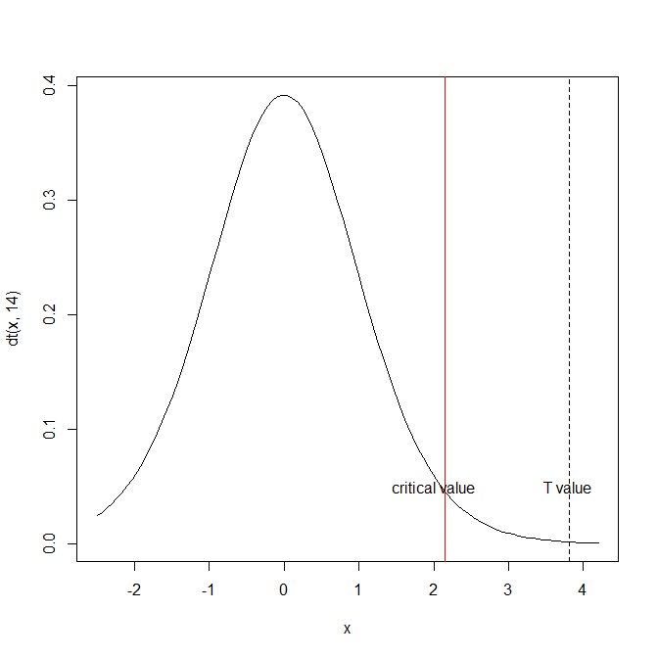
One sample t-test: p-value
In our example we observed T = 3.8172.
We want to find
P(t > |T|) and double it.
The area on the right
from the dotted line.

Slide 38
One sample t-test: p-value
Using R in our example this is equal to
2 * pt(- abs($3.8172$), 15 - 1) = 0.001885684 < 0.05
If H0 was true, the probability that the mean is equal to 100 is equal to 0.0019.
So it seems unlikely that the true mean could be equal to 100.
It does not mean it is not, it merely means that based on our sample, we have (strong) evidence to reject the null hypothesis.

Slide 39
One sample t-test and confidence interval
95% confidence interval for the true mean would be given by
$\left(\overline{x} − t_{1−\frac{a}{2}, n−1}\frac{s}{\sqrt{n}},\overline{x}+ t_{1−\frac{a}{2}, n−1}\frac{s}{\sqrt{n}}\right)=$
$\left(126.7116 −2.144787\frac{27.10216}{\sqrt{15}}, 126.7116 −2.144787\frac{27.10216}{\sqrt{15}}\right)=$
$\left(111.7029, 141.7203\right)$
Clearly μ = 100 is outside the above confidence interval.
The (1-α)% confidence interval shows the values for which the Ho is not rejected at a significance level α%.

Slide 40
One sample t-test in R
R command for the one sample t-test
t.test(x, mu = 100)
One Sample t-test
data: x
t = 3.8172, df = 14, p-value = 0.001886
alternative hypothesis: true mean is not equal to 100
95 percent confidence interval:
111.7029 141.7203 ## 100 is not included in the confidence interval
sample estimates:
mean of x
126.7116

Slide 41
Two samples t-test
Going back to our example again, we want to test the hypothesis that the gene expressions are the same regardless of whether the patient has mutation in BRCA1 or not.
$H_{0} :μ_{1}=μ_{2}$ versus $H_{1}{ : μ}_{1}≠μ_{2}.$
The Welch’s t-test statistic is

Slide 42
Two samples t-test
Why this version and not the original t-test test statistic?
The above version requires the two variances two be equal (another hypothesis test).
If the variances cannot be assumed equal, Welch’s version should be used.
If the variances are equal, Welch’s version is still correct.

Slide 43
Two samples t-test
Welch’s test still follows the t distribution, but with modified degrees of freedom
Too difficult to remember, so we skip it.

Slide 44
Two samples t-test
If we plug in all the numbers in the Welch formula we get
$T= \frac{\left|111.7026 −143.8648\right|}{\sqrt{\frac{785.671}{8}+\frac{153.6497 }{7}}}=2.9341$ and the estimated degrees of freedom are 9.9017.
The p-value from R is equal to 0.01509 < 0.05.

Slide 45
Should We Accept Our Null Hypothesis?
Maybe we are just unlucky. Maybe H does not hold and still got these numbers.
Statistics to the rescue:
If Ho is true then we have a 0.015 chance to observe this extreme or more extreme difference in the means in our data
Clearly we must reject the null hypothesis that the population means, from which the two samples came, are equal.

Slide 46
Two samples t-test in R
t.test(x1, x2)
Welch Two Sample t-test
data: x1 and x2
t = -2.9341, df = 9.9017, p-value = 0.01509
alternative hypothesis: true difference in means is not equal to 0
95 percent confidence interval:
-56.619303 -7.705086 ## zero is not included in the difference
sample estimates:
mean of x mean of y
111.7026 143.8648

Slide 47
Two samples t-test in R
Let us now perform the classical t-test assuming equality of the variances
t.test(x1, x2, var.equal = TRUE)
Two Sample t-test
data: x1 and x2
t = -2.796, df = 13, p-value = 0.01514 ## similar result as before
alternative hypothesis: true difference in means is not equal to 0
95 percent confidence interval:
-57.01236 -7.31203 ## zero is not included in the difference
sample estimates:
mean of x mean of y
111.7026 143.8648
The fact that the two versions agree does not necessarily mean that the variances are equal. In general, prefer the Welch’s version.

Slide 48
Permutation based two samples t-test
The t-test assumes that each of the populations from which the two samples came follow a normal distribution (parametric test). What if this assumption is wrong? For large samples, say 30 and above this is not a big problem. What about smaller sample sizes?
The answer is calculation of the p-value based on permutations. No assumptions required, neither for the distribution nor for the variances.
Only the availability of a computer.

Slide 49
Parametric versus non-Parametric Tests
Parametric test:
makes the assumption that the data are sampled from a particular class of distributions
in our example we assumed our data come from normal distributions
Non-Parametric test
does not assume a particular class of distributions
With parametric assumptions it becomes easier to derive the distribution of our test statistic

Slide 50
Permutation Testing
In bioinformatics data we typically do not know much about the data distribution
How do we obtain the distribution of our test statistic?
Great idea in statistics: permutation testing
Recently practical because it requires computing power (or a lot of patience)

Slide 51
Permutation Testing
In our example, we want to calculate p(t|H₀)
If H₀ , then it does not matter which group each value x_{i}¹ comes from
Then, if we permute the group labels, we would get a value for our test statistic given the null hypothesis holds
If we get a lot of such values, we can estimate (approximate) p(t|H₀)!

Slide 52
Permutation Algorithm
To obtain an estimated p-hat(t|H₀):
For each possible permutation B of the group labels (or as many as you have time)
Calculate the test statistic t_{B}
p-hat(t|H₀) = #{|t₀| ≤ |t_{B} |} / #B

Slide 53
Permutation Testing
p-value = P(|T| ≥ |t_{o}| | H₀)
area under the curve of the pdf further away from t_{o}
p-value as estimated from permutation testing?
p-value = P-hat(|T| ≥ |t_{o}| | H₀)?
Percentage of times |t_{B}| ≥ |t_{o}|
p-hat(|T| ≥ |t_{o}| | H₀) = #{|t_{B}| ≥ |t_{o}| } / #B

Slide 54
Permutation based two samples t-test
1. Let us choose the test statistic as $D_{obs}=|\overline{x} −\overline{y}$|.
2. Combine all observations in one sample
$Z=\left(x_{1}, …,x_{n_{x}},y_{1}, …,y_{n_{y}}\right)$ and ${n=n_{x}+n}_{y}$ is the total sample size
3. Let W denote the sample $W= \left\{\begin{matrix}1 for the first sample \\ 2 for the second sample\end{matrix}\right\}$
4. Sample n observations from W.
5. Calculate $D_{i}= \left|\overline{Z}\left[w==1\right]−\overline{Z}\left[w==2\right]\right|$
6. Repeat steps 4-5 R times. Usually R = 999.
(In general for any permutation based test) estimate the p-value as
$\frac{\#\left\{D_{i}≥D_{obs}\right\}+1}{R+1}$

Slide 55
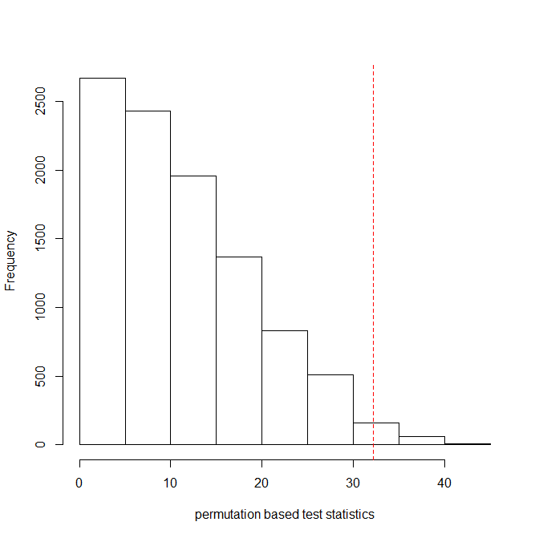
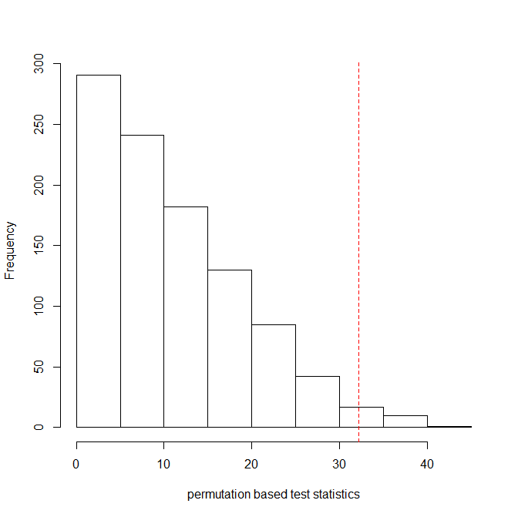
Permutation based two samples t-test
R = 999 R = 9999
p-value = 0.01 p-value = 0.015

Slide 56
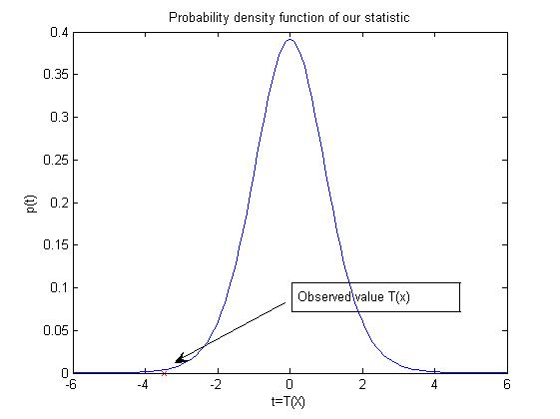
Does It Really Work?
True distribution calculated theoretically

Slide 57
Does It Really Work?
True distribution calculated theoretically
Estimated distribution from our data: 100 permutations

Slide 58
Does It Really Work?
True distribution calculated theoretically
Estimated distribution from our data: 1000 permutations

Slide 59
Does It Really Work?
True distribution calculated theoretically
Estimated distribution from our data: 10000 permutations

Slide 60
Permutation Testing Limitations
The more data we have the more our estimations will approximate the true distribution of T
if not enough permutations possible, the approximation will not be good
The more permutations we perform, the better the estimation
Assumes a permutation is possible under the null hypothesis
leads to subtle assumptions
Requires lots of computing power

