Slide 1
Introduction to Programming
Lecture 01: Introduction to Linux 10/10/2016

Slide 2
Why Bioinformatics???
I visited her Group in 2006 looking for a PhD position. As usually, we had a chat after my presentation… and I asked her why she is doing Bioinformatics.
…. She did not want to analyze data
…. She did not want to do something modern
…. She did not even think that it is useful
…. She just likes it

Slide 3
What is Bioinformatics
Paulien Hogeweg (b. 1943) is a Dutch theoretical biologist and complex systems researcher studying biological systems as dynamic information processing systems at many interconnected levels. In 1970, Ben Hesper and she defined the term bioinformatics as "the study of informatic processes in biotic systems".

Slide 4
What is Bioinformatics for you ?
Data analysis. Large data
Pattern recognition tool , automating things, avoiding lab work, simulations, statistical analysis, algorithm development for biological processes, retrieve data, producing knowledge from combining existing knowledge, genome analysis, modeling, computational methods to answer biological questions, tools to do something

Slide 5
Using computers to study biological systems
Production of data from biological systems → Lots of data → Use computers to analyze them
Production of data from biological systems → Complicated data → Use computers to analyze them Let’s explain every word in these two phrases
1. Production of data, 2. Biological systems, 3. Lots of data, 4. Analyze, 5. Complicated data

Slide 6
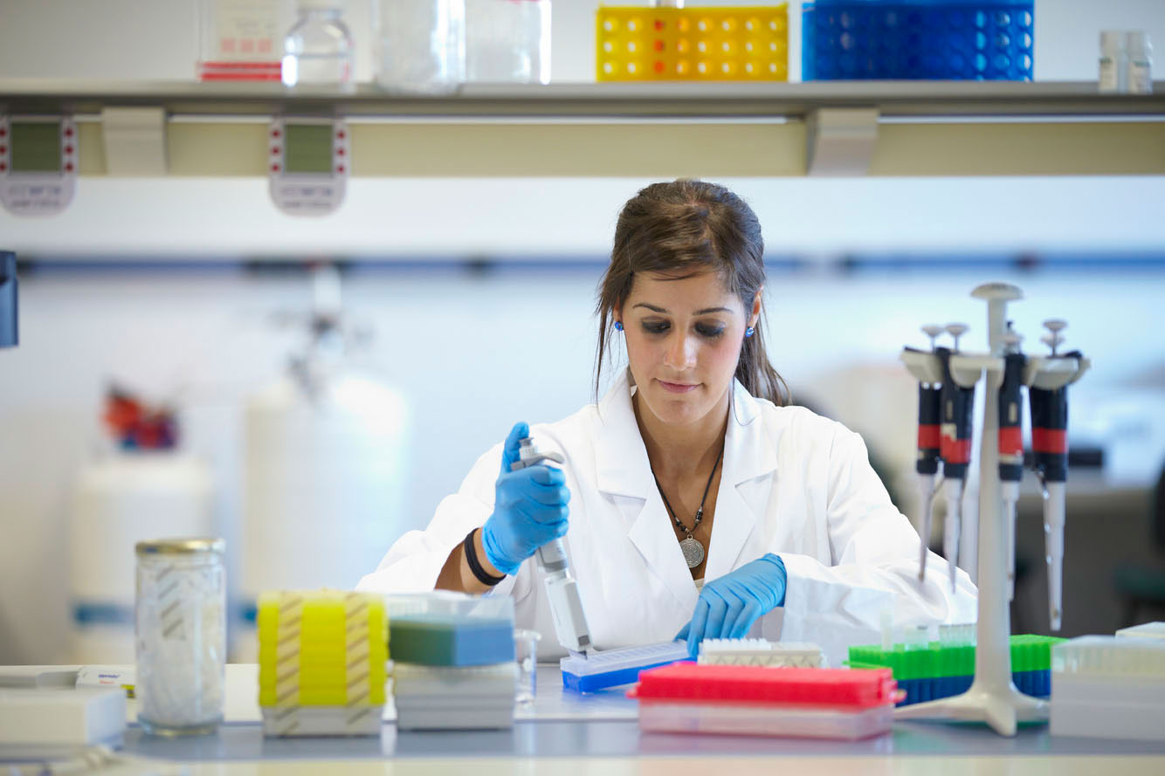
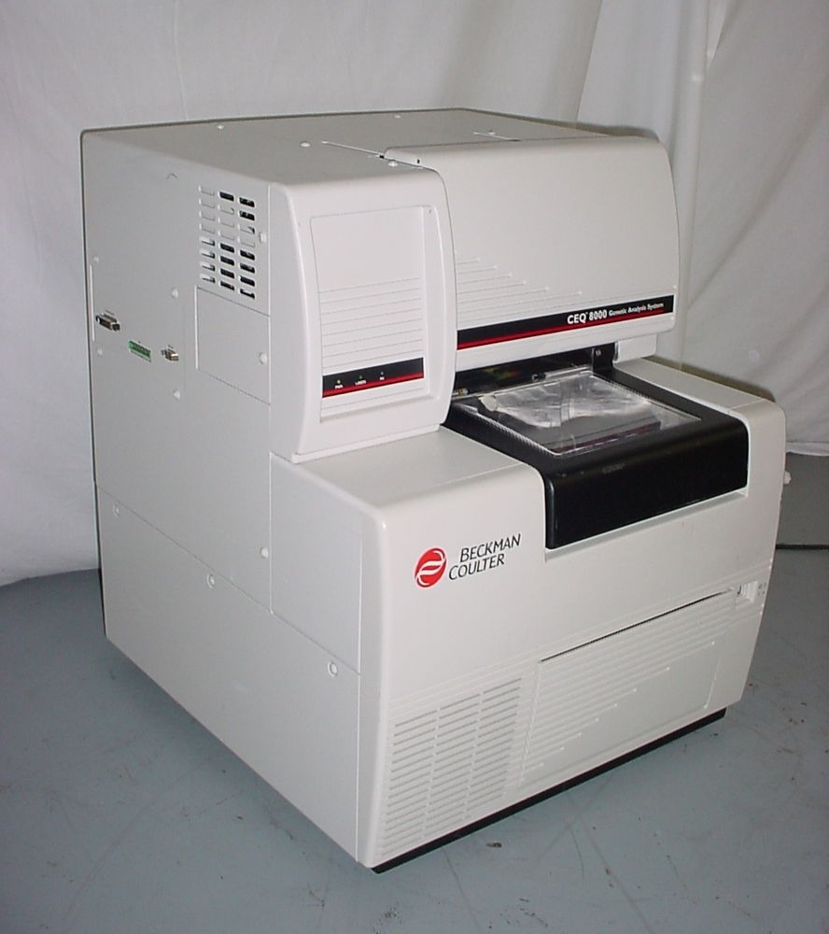
Writing Computer Programs to deal with data
Computer programs for data analysis
Data analysis
DATA
ANALYSIS

Slide 7
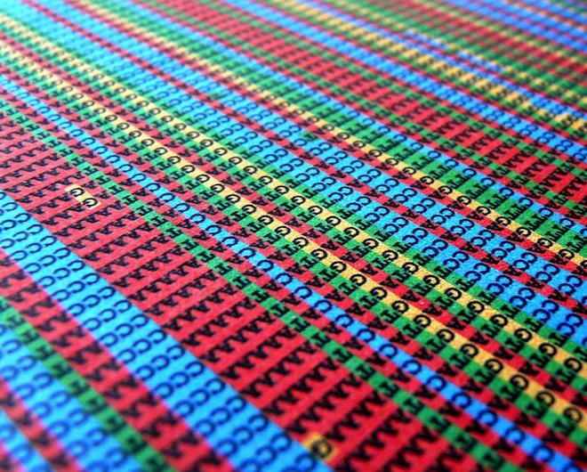
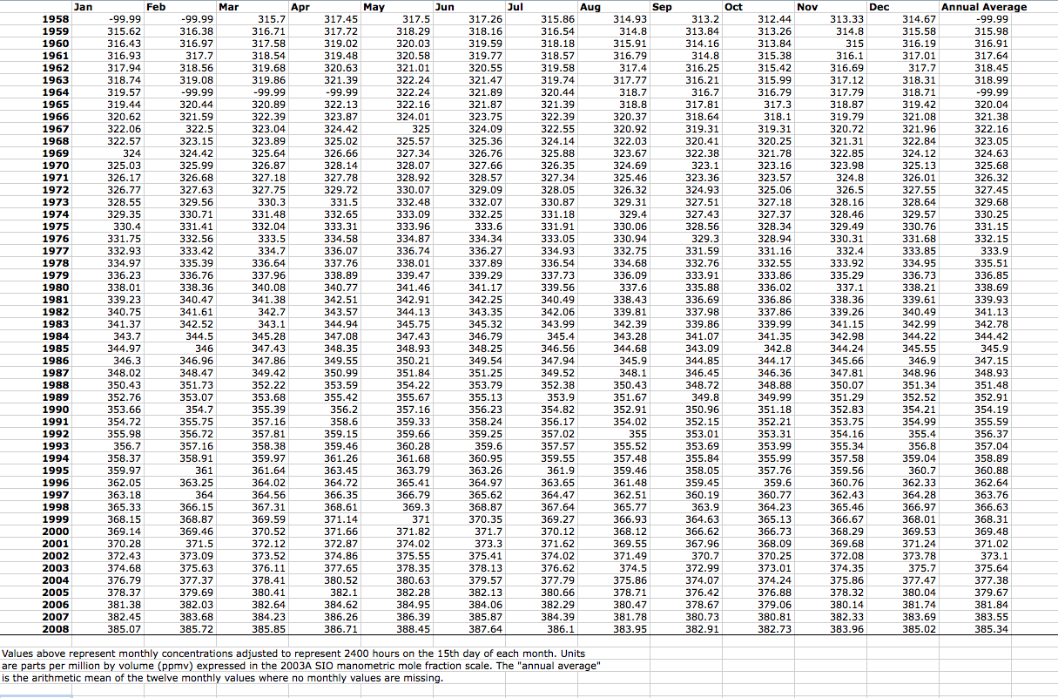
DATA
Qualitative
Quantitative

Slide 8
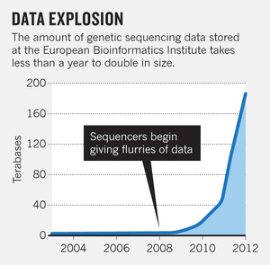
How much data is out there?
….. LOTS OF DATA
No way to:
analyze them manually
Have an intuition what they really mean

Slide 9
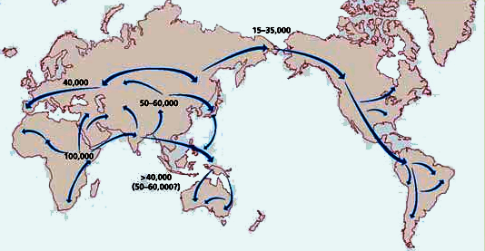
ANALYSIS AND RESULTS

Slide 10
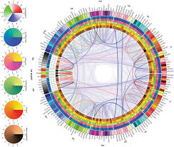
ANALYSIS → NEW DATA → NEW RESULTS ….

Slide 11
It’s a mess… I’m getting dizzy with all that...

Slide 12
Get used to that….
Think a lot about the problem before attempting to solve it
Try small steps and reach small results
Write down what you are doing
After that, think again about the whole process. Is it really what you were intending to do
Understand the software and algorithms you are using
Use an analysis that can be reproduced.
REPRODUCED: You or somebody else can do exactly the same you have done and reach the same results.

Slide 13
REPRODUCIBILITY
Watch the video at home.
It’s a bit advanced for you at this moment, but you will get an idea about what we will deal with during the Master’s Program.

Slide 14
Example
Download the file lecture01.csv http://139.91.162.50/BioinformaticsGraduate/
Calculate the average of the last ⅓ of the lines for every column.
Make a barplot of the average values

Slide 15
What we need to remember from the example
The first step for reproducibility is to be able to describe precisely what we have done.
With tones of data, and hundreds of steps during the analysis, this is not really possible.
Using a set of commands that precisely say what we have done is the best way towards reproducible science.
We will see how linux and programming facilitates that.
Of course the most important factor for achieving reproducibility is YOU.

Slide 16
Writing down commands facilitates your research
Writing down commands makes you work faster
Communicate your research and have less mistakes

Slide 17
Linux facilitates such a working paradigm
With linux and programming we tend to write down the commands we used during analysis.

Slide 18
Is it Λίνουξ ορ Λάινουξ
https://upload.wikimedia.org/wikipedia/commons/0/03/Linus-linux.ogg

Slide 19
…. Of course there are many many more advantages compared to windows

Slide 21
Tux is a penguin character and the official mascot of the Linux kernel.^{[1]} Originally created as an entry to a Linux logo competition, Tux is the most commonly used icon for Linux, although different Linux distributions depict Tux in various styles. The character is used in many other Linux programs and as a general symbol of Linux.

Slide 22
Hey… wait a sec… Windows are much much much much more convenient
Coding is difficult and it is for geeks
Linux is difficult and it is for geeks
I want my EXCEL back, it is much easier.

Slide 23
Is it really easy to use Windows?
On everyday life
You just need to hack everything in order to use windows (adobe, office, find cracks etc)
To understand how difficult it is just imagine what you need to describe to a child who has no idea about computers how to have a fully functioning PC with windows

Slide 26
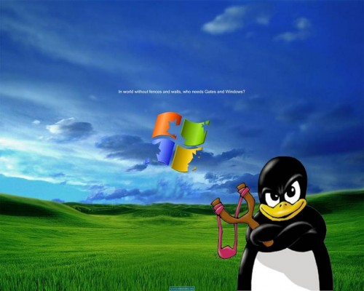

Slide 27
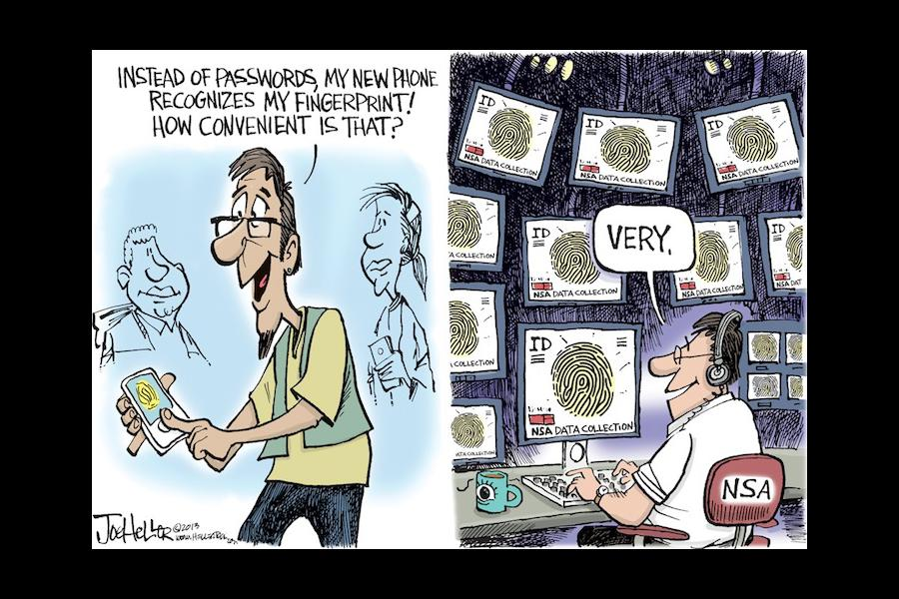
Is always convenience great?

Slide 28
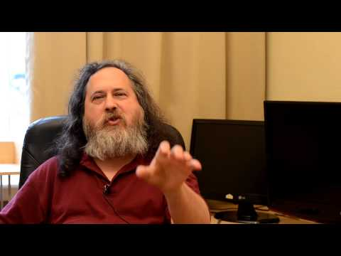
Richard Stallman on convenience
… actually judging Ubuntu

Slide 29
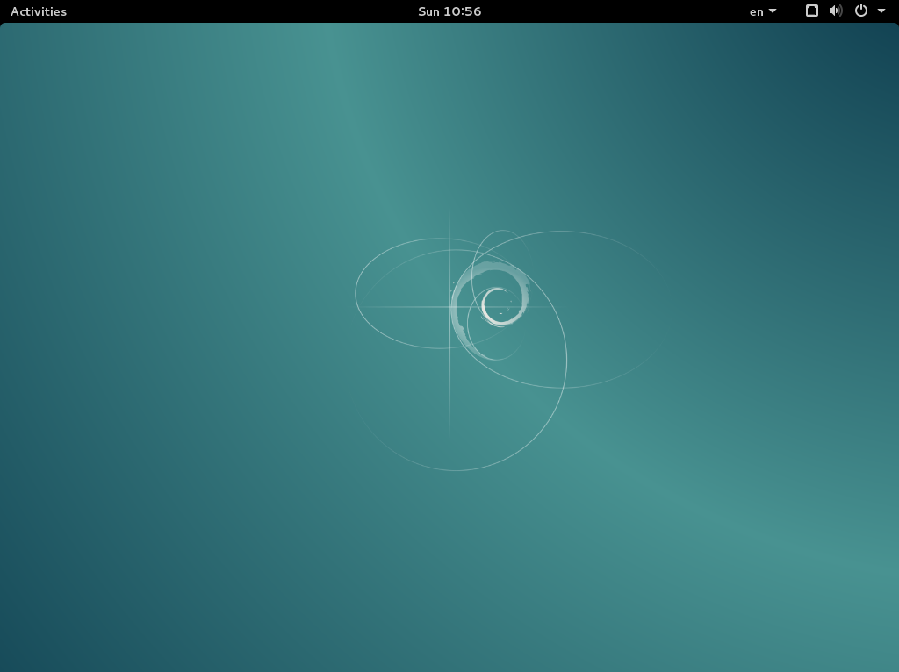
We will use Debian
Next time we will see how to install Debian
NOW LET’S EXPLORE LINUX

Slide 30
LINUX IS JUST FINE FOR EVERYDAY USE

Slide 31
What is the Shell?
The Shell is any program that can accept commands from the keyboard and forward them to the OS so they can be executed, acting as a command-line interpreter
used to be the only interface, before GUIs were introduced
allows tasks to be performed one after another (piping)
allows very complicated tasks to be performed in even one line
most commonly used shell: bash

Slide 32
Shell
username
pavlos@mypc:~$
host (PC)
pwd : current directory
3 + 6 = 9
3 * 6 = 18
3 + 6 = 9
3 * 6 = 18
pavlos@mypc:~$ pwd
/home/pavlos
ls: directory contents
pavlos@mypc:~$ ls
Documents Music Public myfile.txt
Downloads Pictures Videos

Slide 33
Shell
cd: change directory
cd xxxx : go to directory xxxx
pavlos@mypc:~$ cd Documents
pavlos@mypc:~/Documents#
pavlos@mypc:~/Documents# pwd
/home/pavlos/Documents
cd ..: go one directory up
pavlos@mypc:~/Documents# cd ..
pavlos@mypc:~$
pavlos@mypc:~$ pwd
/home/pavlos/

Slide 34
Shell
cd: change directory
mkdir xxxx : make a directory callled xxxx
pavlos@mypc:~$ ls
Documents Music Public myfile.txt
Downloads Pictures Videos
pavlos@mypc:~$ mkdir myNewDirectory
pavlos@mypc:~$ ls
Documents Music Pictures myfile.txt
Downloads myNewDirectory Public Videos

Slide 35
Let’s now use our editor and implement our first program
Make a directory called “introduction_to_programming”
Go in it
Make a second directory called “lecture_01”
Go in it
Open with the editor a file called “program_01.py”
Create a variable that stores your name
… print it

