Slide 1
Correlation – Regression
Michail Tsagris & Ioannis Tsamardinos

Slide 2
Continuous data
Continuous data are data that can take any value, either within a specific range or anywhere on the real line. E.g. weight, height, time, glucose level, etc.

Slide 3
Continuous data
Continuous data are data that can take any value, either within a specific range or anywhere on the real line. E.g. weight, height, time, glucose level, etc.
Suppose now that we have measurements from two or more quantities and want to see whether there is a (linear) relationship between them or not.

Slide 4
Correlation
Continuous data are data that can take any value, either within a specific range or anywhere on the real line. E.g. weight, height, time, glucose level, etc.
Suppose now that we have measurements from two or more quantities and want to see whether there is a (linear) relationship between them or not.
The answer is either Pearson’s (most popular) or Spearman’s correlation coefficient.

Slide 5
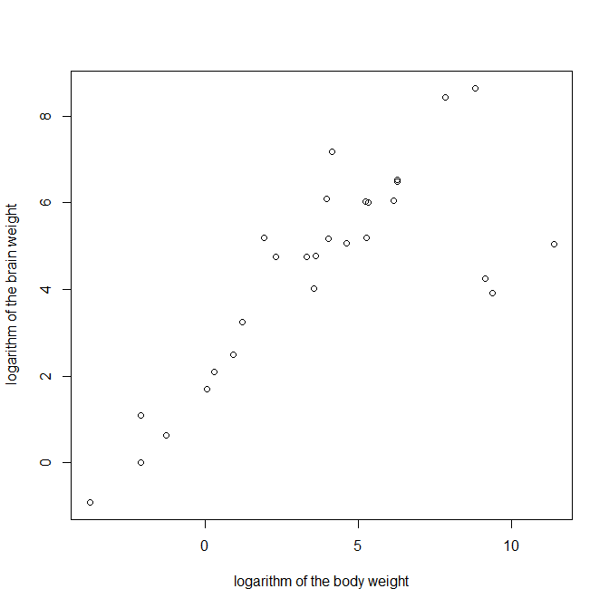
Scatter plot

Slide 6
Scatter plot
Observe the positive trend. Body weight increases, so does the brain
weight.

Slide 7
Can we quantify this relationship?
We want a number to describe this relationship, something to concentrate as much information we get from this graph as possible.
The answer is the Pearson’s correlation coefficient.
For this dataset its value is 0.78 (!! what does it mean?)

Slide 8
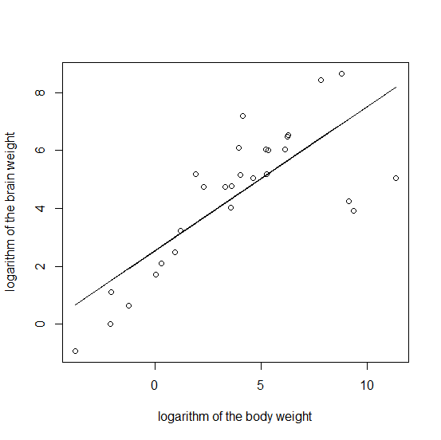
Scatter plot revisited

Slide 9
Pearson correlation coefficient
The coefficient usually denoted as r (ρ for the population) between two variables X and Y is defined as
$r= \frac{n\sum_{i=1}^{n}{x_{i}y_{i}−\sum_{i=1}^{n}{x_{i}}\sum_{i=1}^{n}{y_{i}}}}{\sqrt{n\sum_{i=1}^{n}{x_{i}^{2}−{\left(\sum_{i=1}^{n}{x_{i}}\right)}^{2}}}\sqrt{n\sum_{i=1}^{n}{y_{i}^{2}−{\left(\sum_{i=1}^{n}{y_{i}}\right)}^{2}}}}$,
where n is the number of measurements.
The coefficient takes values between -1 (perfect negative correlation) and 1 (perfect positive correlation).

Slide 10
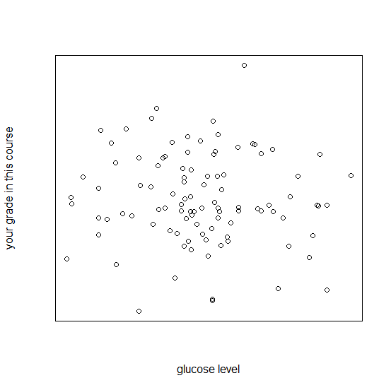
Pearson correlation coefficient
Zero values indicate lack of linear relationship.

Slide 11
Example
Gene X | Gene Y
6 | 5
5 | 4
7 | 6
4 | 7
7 | 6

Slide 12
Example
 | Gene X | Gene Y
 | 6 | 5
 | 5 | 4
 | 7 | 6
 | 4 | 7
 | 7 | 6
Sum | 29 | 28

Slide 13
Example
 | Gene X | Gene Y | X*Y | X² | Y²
 | 6 | 5 | 30 | 36 | 25
 | 5 | 4 | 20 | 25 | 16
 | 7 | 6 | 42 | 49 | 36
 | 4 | 7 | 28 | 16 | 49
 | 7 | 6 | 42 | 49 | 36
Sum | 29 | 28 | 162 | 175 | 162

Slide 14
Example
$r= \frac{n\sum{xy−\sum{x}\sum{y}}}{\sqrt{n\sum{x^{2}−{\left(\sum{x}\right)}^{2}}}\sqrt{n\sum{y^{2}−{\left(\sum{y}\right)}^{2}}}}$
$r= \frac{5∗162 −29 ∗28}{\sqrt{5 ∗175−{29}^{2}}\sqrt{5 ∗162−{28}^{2} }}=−0.067$
Close to 0, not so strong linear relationship.

Slide 15
Spearman’s correlation coefficient
What about Spearman’s correlation coefficient?
Spearman’s correlation is basically the Pearson’s correlation applied to the ranks(?) of the data.
We rank each variable separately and use the ranks to calculate the Pearson’s correlation coefficient.

Slide 16
Example: ranks
Gene X | Gene Y | Rx | Ry
6 | 5 | 3 | 2
5 | 4 | 2 | 1
7 | 6 | 4.5 | 3.5
4 | 7 | 1 | 5
7 | 6 | 4.5 | 3.5

Slide 17
Pearson or Spearman?
Pearson implies that the data are normally distributed, each variable follows a normal distribution.
Spearman assumes that the ranks follow a normal distribution. Thus, more robust to deviations from normality.
Pearson is sensitive to oultiers (data far from the rest).
Spearman is very robust to outliers.
Pearson has better theoretical properties.

Slide 18
Hypothesis test for the correlation coefficient
How can we test the null hypothesis that the true correlation is equal to some specified value?
$Ho: ρ= ρ_{0}$
$H_{1}: ρ≠ ρ_{0}$

Slide 19
Hypothesis test for the correlation coefficient
We will use Fisher’s transformation
$h=0.5∗log⁡(\frac{1+r}{1−r})$
$h_{0}= 0.5∗log⁡(\frac{1+r_{0}}{1−r_{0}})$ (under $H_{0}$)
$h_{1}= 0.5∗log⁡(\frac{1+r_{1}}{1−r_{1}})$ (under $H_{1}$)
$T_{p}=\frac{h_{1} −h_{0}}{1/\sqrt{n −3}}$ Pearson correlation
$T_{s}=\frac{h_{1} −h_{0}}{1.029563/\sqrt{n −3}}$ Spearman correlation

Slide 20
Hypothesis test for the correlation coefficient
If $\left|T_{p}\right| or\left|T_{s}\right|≥t_{1−\frac{a}{2}, n −3}$ reject the H0.
If n > 30 you can also use the next decision rule
If$\left|T_{p}\right| or\left|T_{s}\right|≥Z_{1−\frac{a}{2}}$ reject the H0.
For the case of $ρ=0$, the two Ts become
$T_{p}=\frac{h_{1} }{1/\sqrt{n −3}}$ Pearson correlation
$T_{s}=\frac{h_{1}}{1.029563/\sqrt{n −3}}$ Spearman correlation

Slide 21
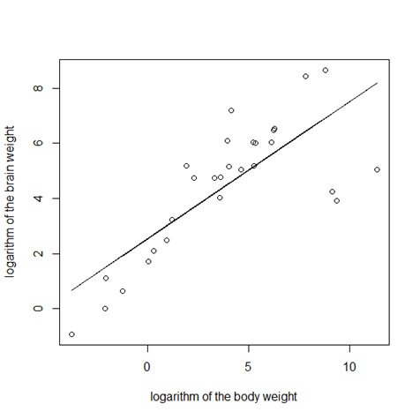
Simple linear regression What is the formula of the line segment?

Slide 22
Simple linear regression
The formula is
${\hat{y}}_{i}= \hat{a}+ \hat{b}x_{i}+ {\hat{e}}_{i}$.
In order to estimate the $\hat{a}$and $\hat{b}$ we must minimise the sum of the squared residuals ${\hat{e}}_{i}$:
Minimise $\sum_{i=1}^{n}{{{\hat{e}}_{i}}_{}^{2}}$ = $\sum_{i=1}^{n}{{\left({\hat{y}}_{i}−a−bx_{i}\right)}^{2}}$
with respect to $a$ and $b$.

Slide 23
Estimates of a and b
$\hat{b}= \frac{n\sum{xy−\sum{x}\sum{y}}}{n\sum{x^{2}−{\left(\sum{x}\right)}^{2}}}$ (r = $\frac{n\sum{xy−\sum{x}\sum{y}}}{\sqrt{n\sum{x^{2}−{\left(\sum{x}\right)}^{2}}}\sqrt{n\sum{y^{2}−{\left(\sum{y}\right)}^{2}}}} )$
$\hat{a}= \overline{y} −\hat{b}\overline{x}$
$\hat{a}:$ if x is zero, the estimated value of y.
$\hat{b}$: the expected change in y if x is increased ( decreased) by a unit (in x values).

Slide 24
Multiple regression
${\hat{y}}_{i}= \hat{a}+ \sum_{j=1}^{p}{{\hat{b}}_{j}x_{j}}+ {\hat{e}}_{i}$.
The estimation of betas uses matrix algebra.

Slide 25
Dummy variables
Sex = Male or Female.
S = {0, 1},
Where 0 stands for M (or F) and 1 stands for F (or M).
Race = White, Black, Yellow, Red.
R1 = 1 if White and 0 else
R2 = 1 if Black and 0 else
R3 = 1 if Yellow or else.
Red is the reference value in this case.

Slide 26
Coefficient of determination
$R^{2}:$The percentage of variance of y explained by the model (or the variable(s)).
$R^{2}=1 − \frac{\sum_{i=1}^{n}{{\left(y_{i}−a−bx_{i}\right)}^{2}}}{\sum_{i=1}^{n}{{\left(y_{i}−\overline{y}\right)}^{2}}}$ = $1 − \frac{SSE}{SST}$
$R^{2}$ = cor(y, $\hat{y}).$

Slide 27
Categorical data
What if we have categorical data?
How can we quantify the relationship between gender and smoking in young ages, gender and lung cancer, smoking and lung cancer for example?
How can we decide whether these pairs are statistically dependent or not?
The answer is G² test of independence.
Ho : The two variables are independent
H1: The two variables are NOT independent

Slide 28
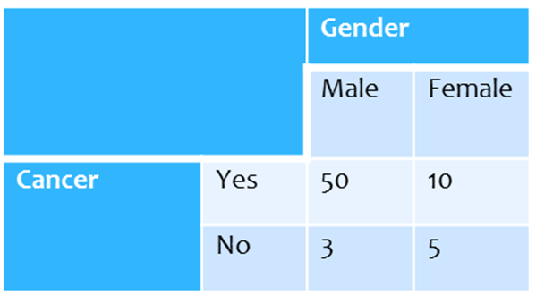
G² test of independence

Slide 29
G² test of independence
$G^{2}=2 ∗ \sum_{i, j}{n_{ij}log{\frac{n_{ij}}{e_{ij}}}}$,
where “e” and “n” denote the expected and the observed frequencies respectively. The 2 variables have I and J distinct values and i = 1, 2, …, I and j = 1, 2,…, J. But how do we calculate the “e” terms?
$e_{ij}= \frac{n_{i. }n_{.j }}{n}$, where $n_{i. }$ is the total of the i-th row, $n_{.j }$is the total of the j-th column and n is the sample size.

Slide 30

G² test of independence
 |  | Gender |  | Totals
 |  | Male | Female
Cancer | Yes | $$n_{11 }=50$$ | $$n_{12 }=10$$ | $$n_{1. }= 60$$
 | No | $$n_{21 }=3$$ | $$n_{22 }=5$$ | $n_{2. }=$ 8
Totals |  | $$n_{.1 }=53$$ | $$n_{.2 }=15$$ | $$n=68$$
$e_{11}=\frac{n_{1. }∗ n_{.1 }}{n}= \frac{60 ∗ 53}{68}=$46.76
$e_{12}=\frac{n_{1. }∗ n_{.2 }}{n}=\frac{60 ∗ 15}{68}=13.24$
$e_{21}=\frac{n_{2. }∗ n_{.1 }}{n}=\frac{8 ∗ 53}{68}=$ 6.24
$e_{22}=\frac{n_{2. }∗ n_{.2 }}{n}=\frac{8 ∗ 15}{68}=$ 1.76

Slide 31
G² test of independence
$G^{2}=2 ∗( 50∗log{\frac{50}{46.76}}+10∗log{\frac{10}{13.24}}+$
$3∗log{\frac{3}{6.24}}$+$5∗log{\frac{5}{1.76} )}$ = 2 * 3.57 = 7.14
What is next?

Slide 32
G² test of independence
We need to see whether G² =7.14 is large enough to reject the null hypothesis of independence between the two variables.
We need a distribution to compare against.
The answer is X² at some degrees of freedom.
DF = (#rows - 1) * (# columns - 1)
In our example (2 - 1) * (2 - 1) = 1
Since G² =7.14 < $X_{1, 0.95}^{2}$ = 3.84 we reject the null hypothesis. Hence the two variables can be considered dependent (statistically speaking) or non independent.

